Slide 1
EMAIL SPAM DETECTION
Guided by :-
Krian V K
Assistant Professor
GROUP NO:5
Anand Sekhar P C
Arya S Dhrisya S Archana P Nair

Slide 2
CONTENT
Problem Definition
Objective of the Work
Feasibility Analysis
Tool Specification
Methodology
Reference
2

Slide 3
PROBLEM DEFINITION
Importance of Email:
Email has become a fundamental tool in both personal and professional environments, facilitating communication, collaboration, and decision-making.
However proliferation of spam emails presents several challenges
Proliferation of Spam:
What is Spam?: Unsolicited emails, often sent in bulk, that can range from advertisements to malicious content.
Volume: Over 50% of global email traffic consists of spam, according to recent studies.
3

Slide 4
PROBLEM DEFINITION
Challenges Posed by Spam:
Reduced Productivity: Users spend significant time sorting, identifying, and deleting spam from their inboxes, leading to loss of focus and efficiency.
Security Threats: Spam often includes phishing links, malware attachments, or scams, putting personal data, financial information, and organizational security at risk.
User Frustration: Continuous encounters with spam can lead to frustration and a lack of trust in email as a reliable communication tool.
4

Slide 5
SIGNIFICANCE OF THE PROBLEM
Time Wastage: Users spend significant time identifying and deleting spam emails.
Security Risks: Spam emails often contain phishing links or malicious attachments that can compromise user data and security.
Resource Consumption: Handling and storing large volumes of spam emails consume significant server resources and bandwidth.
User Frustration: Repeated encounters with spam emails can lead to user frustration and reduced trust in email communication systems.
5

Slide 6
ABSTRACT:
Email communication is an integral part of both personal and professional interactions. However, the proliferation of spam emails presents a significant challenge, leading to reduced productivity and potential security threats. This project addresses the problem by developing a spam detection system using Logistic Regression, a machine learning algorithm well-suited for binary classification tasks.
The first step in the strategy is to gather a labelled dataset of emails that includes both spam and real (ham) emails. Text cleaning, tokenisation, and feature extraction are some of the preparation steps the data goes through to transform the unstructured email content into a format that can be analysed. The performance of the model is then assessed by dividing the dataset into subsets for training and testing.
The processed data is used to train a logistic regression model, which identifies the traits and patterns that set spam emails apart from real ones. The trained model is then used to categorise fresh, unseen emails as either spam or ham after attaining suitable results.

Slide 7
OBJECTIVES
Develop a spam detection model using Logistic Regression to classify emails as spam or ham.
Specific Goals:
Preprocess Email Data
Train the Model
Evaluate and Validate
Deploy for Real-time Prediction

Slide 8

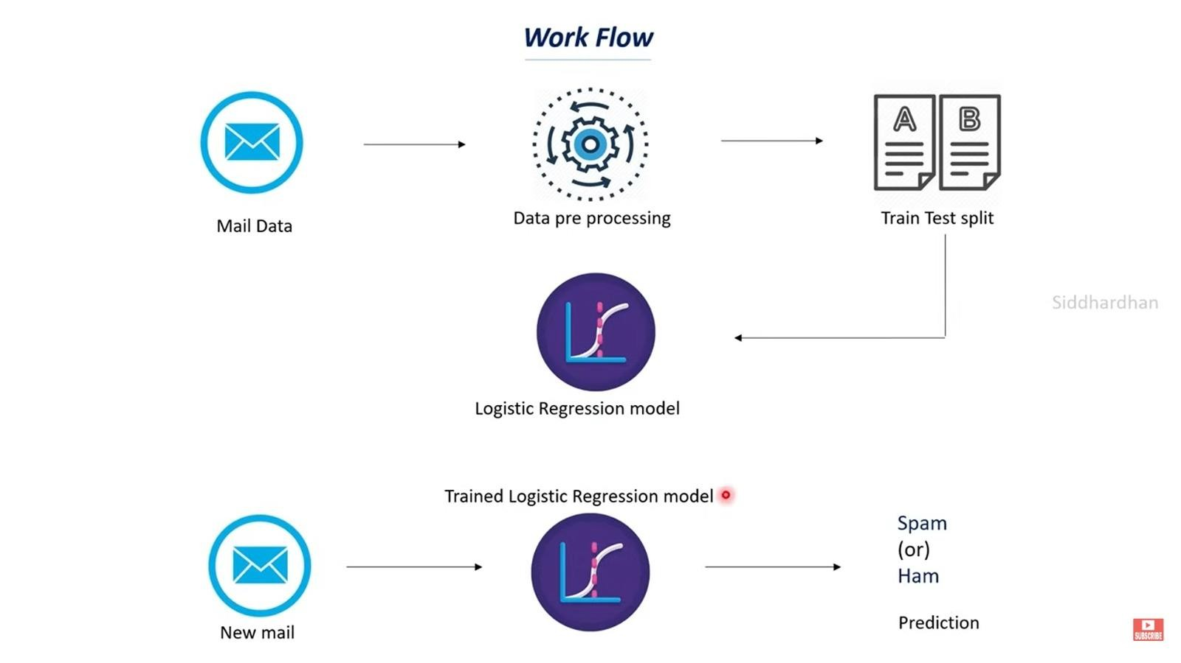

Slide 9
DATA SOURCE
Kaggle dataset
MODEL: LOGISTIC REGRESSION
Logistic Regression is inherently designed for binary classification tasks, where the goal is to predict one of two possible outcomes (e.g., spam vs. ham in email detection).
The model calculates the probability of an instance belonging to a particular class, and based on a threshold (usually 0.5), it classifies the instance into one of the two classes.
Unlike linear regression, which predicts a continuous value, Logistic Regression predicts the probability that a given input belongs to the positive class.
This probabilistic output is particularly useful for classification problems because it allows for easy interpretation and decision-making.

Slide 10
TIMELINE OF ACTIVITIES
ACTIVITY | START DATE | END DATE | REMARK
Problem Identification and Proposal | August 1 2024 | August 8 2024 | Completed
Data Collection and Preprocessing | August 9 2024 | August 20 2024
Model Training and Evaluation | August 21 2024 | August 31 2024
Model Optimization | September 1 2024 | September 10 2024
Final Implementation and Testing | September 11 2024 | September 20 2024
Report Writing and Submission | September 21 2024 | September 30 2024
Final Presentations | October 1 2024 | October 10 2024

Slide 11
REFERENCES
R. Indu and S. C. Dimri, "Detecting Spam E-mails with Content and Weight-Based Binomial Logistic Model," in Journal of Web Engineering, vol. 22, no. 7, pp. 939-959, October 2023, doi: 10.13052/jwe1540-9589.2271.
N. Kumar, S. Sonowal and Nishant, "Email Spam Detection Using Machine Learning Algorithms," 2020 Second International Conference on Inventive Research in Computing Applications (ICIRCA), Coimbatore, India, 2020, pp. 108-113, doi: 10.1109/ICIRCA48905.2020.9183098.
Natasha Sharma. (2018, May). Spam detection with logistic regression. Towards Data Science. https://towardsdatascience.com/spam-detection-with-logistic-regression-23e3709e522
Ellis C., & Brandl R. (2023, October 19). Spam statistics (2024): New data on junk email, AI scams & phishing. EmailToolTester. https://www.emailtooltester.com/en/blog/spam-statistics/

